Slide 1

Project Status Report
Project FlyingMoose
4/9/2012

Slide 2

Project Overview
What the project is about
Creating a digital representation of the board game checkers
Working together as a group to simulate real world software development
Goals of the project
To analyze and plan the entire development by breaking the project into tasks and assigning these tasks to group members that have the required skills

Slide 3

Current Status
Current Progress
Project Description
Quad Chart
Skills Matrix
Project Schedule
Risk Analysis of tasks
Beginning development of Requirements
Finalization of Requirements Documentation
Begin working on GUI
Begin working on backend
Assigning future tasks to members

Slide 4
Project Description
The goal of this project is for each team to develop a working digital version of the game Checkers for the customer, Dr. Sidhu.
The end-product should be an electronic version of the game Checkers in which the user can play a game of checkers against a secondary player, or against the computer. A single game should follow all of the standard rules of checkers: The board should be an eight by eight grid of sixty four squares of alternating color, each player should have twelve pieces, and all legal moves should be possible.
The game should include features that are considered standard for a digital game. For instance, the player has the ability to start new games and exit games, surrender/forfeit a match, and should include a game timer. The AI player will provide a casual level of difficulty against the player. Also, a game statistics system will be created and implemented to record the player’s win and loss records, and number of total games played.
The back-end of the game will be coded using Java, and a GUI will be created to provide a user-friendly interface for playing the game. This GUI will indicate whose turn it currently is, and also present the board placement as the game progresses. Interaction with the GUI should rely mostly on the integration of mouse clicks. An options menu should be accessible during play if the user wishes to exit the game or forfeit a match.
The steps that we will take to complete this project includes:
1. Develop the Overall Project Plan and Operational Requirement
2. Formulate Testable Requirements and Cases
3. Design the Software
4. Implement the Software
5. Test the Software
6. Demonstrate the Software

Slide 5
Project Description Summary
Create an accurate representation of the game of checkers
Features Include
Human vs Human or Human vs CPU gameplay
GUI to allow intuitive control
Statistics tracking
Ability to forfeit a current game
A game time
Coded using Java

Slide 6
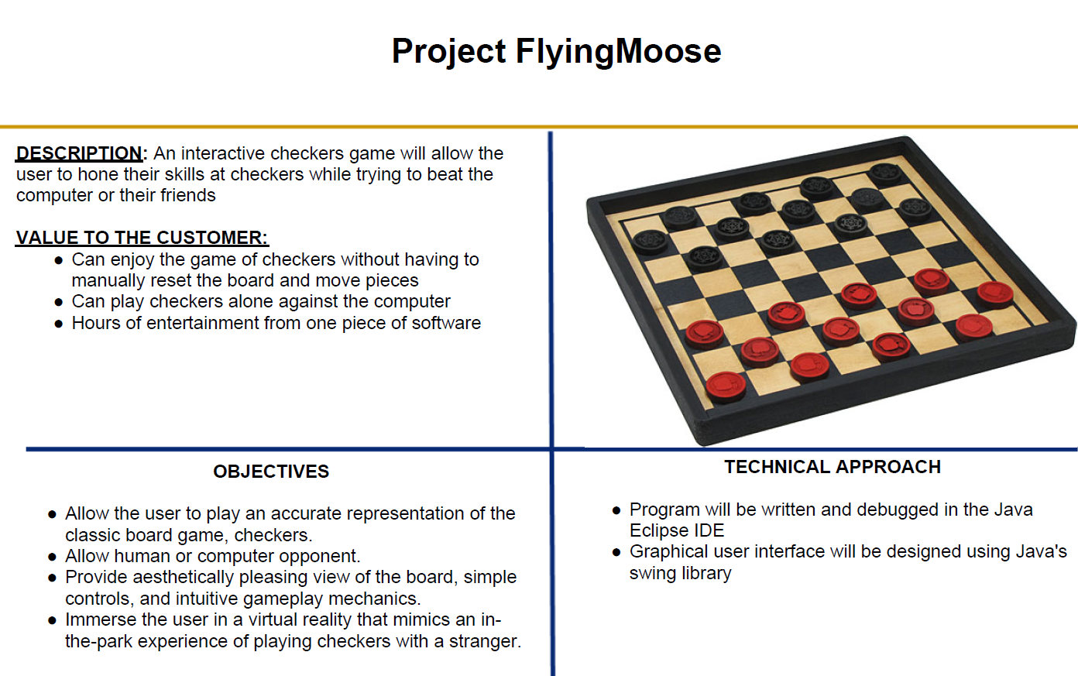

Slide 7
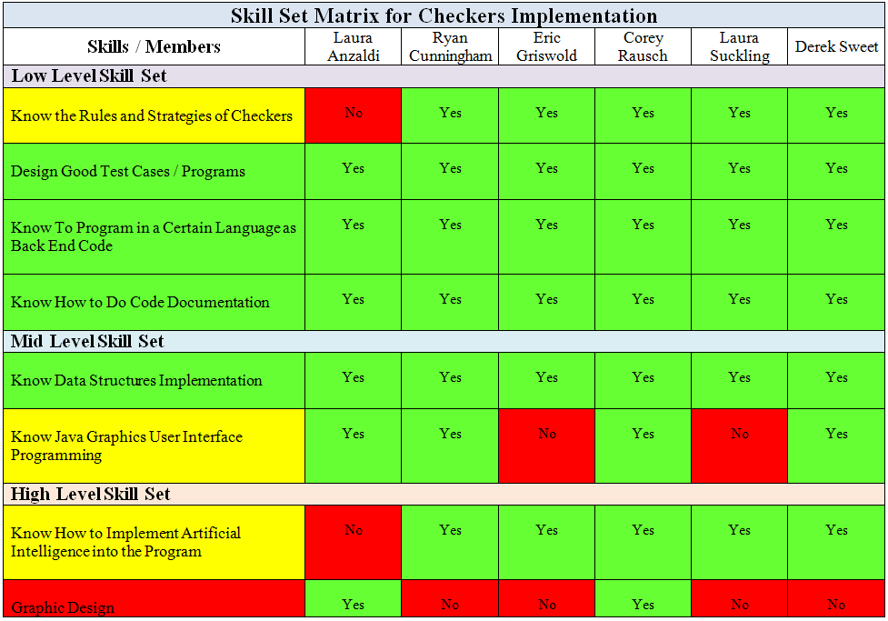
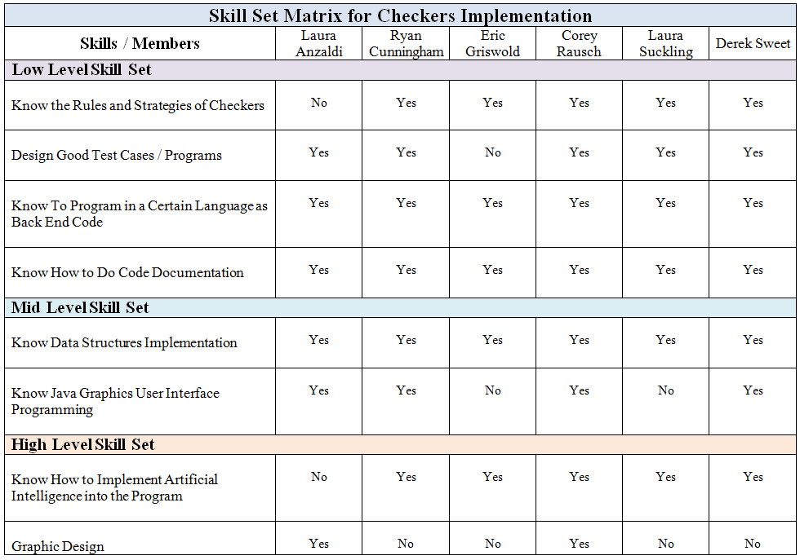

Slide 8
Skill Matrix Summary
All skills have at least one member capable of completing them
Collectively we are very strong in the majority of skills required
Weakest area is GUI

Slide 9
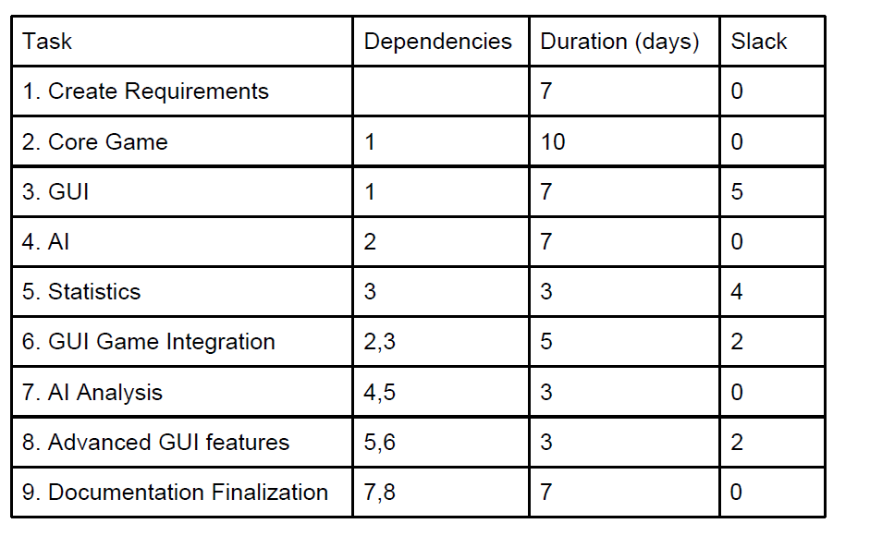
Project Schedule

Slide 10
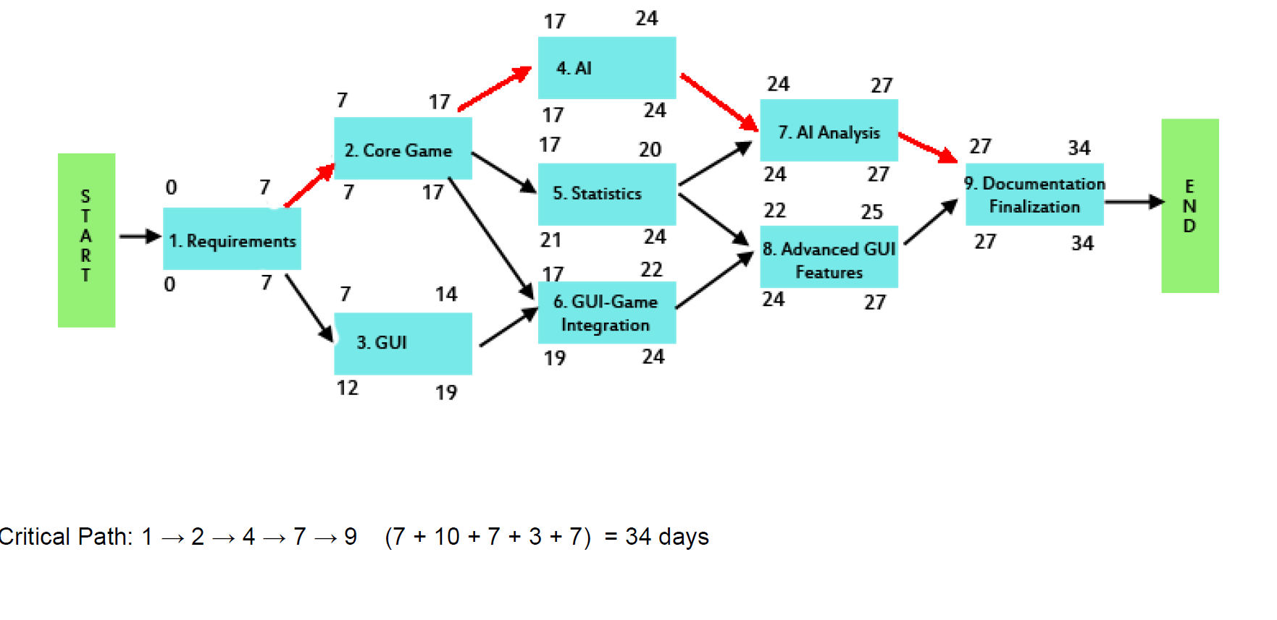
Project Schedule

Slide 11
Project Schedule Summary
Total completion time is estimated at 34 days which will result in the project being completed before the end of the semester
There is a maximum of 3 tasks occurring simultaneously therefor at least 2 people can work together on every task
GUI being our area of weakest expertise also is our task that has the most slack which will help if we encounter difficulties

Slide 12
Risk Analysis
Risk | Likelihood | Severity
Game and GUI do not integrate well | Medium | Very High
Poor time estimation of a task on the schedule | Medium | Medium
AI too easy or too difficult | Low | High
Visually unappealing | Low | Low
Team differences in style and techniques | High | Low

Slide 13
Milestones
Requirements
Core Game Completed
AI Integration
Deliverable: Requirements Documentation
GUI Finalization
Deliverable: A visually appealing interface specializing in ease of use
Deliverable: The ability to now play against an intelligent computer player
Documentation Finalization
Deliverable: Full documentation for the entire project
Deliverable: A full playable version of checkers for 2 humans

Slide 14
Performance Requirements
Requirement | Test
No response delay | All functions relating to response return in less than 1/10th of a second
Pieces move quick (~1 second) | The function(s) that move(s) the piece executes in about 1 second
Computer will take between 1 to 5 seconds per move | At the completion of player turn, AI should begin and finish within 1 to 5 seconds, delay the move if finished before 1 second
Run on multiple operating systems | Run the program on 3 major operating systems
Will not allow memory leaks | Check the programs size in memory

Slide 15
Functional Requirements
Requirement | Test
Highlight the previous move | Eye test; every move should be obvious
At the beginning of every turn, highlight any forced move | Eye test; the player will know if he has a forced move
Highlight the possible moves for the selected piece | Eye test
Keep a Timer | Eye test. Ensure time resets when needed
Accurately save statistics | Confirm all save statistics are stored
Give a hint button | Ensure this button always gives a feasible move
Keep track of the # of live pieces | Confirm total pieces = the number expected
Handle double(and bigger) jumps correctly | Confirm that the game does not prematurely end the turn if a double jump is possible(and therefor required).

Slide 16
Functional Requirements
Requirement | Test
Visually display kings and allow them to move in all directions | Confirm king can move both directions.
Option to surrender | At any moment, ensure player can surrender resulting in a loss
Visually indicate whose turn it is | Eye test, confirm the indicator changes correctly with the turn
Include options menu | Physical test, make sure the menu is present
Access statistics from options | Physical test, ensure the statistic button triggers the player stats

